Slide 1
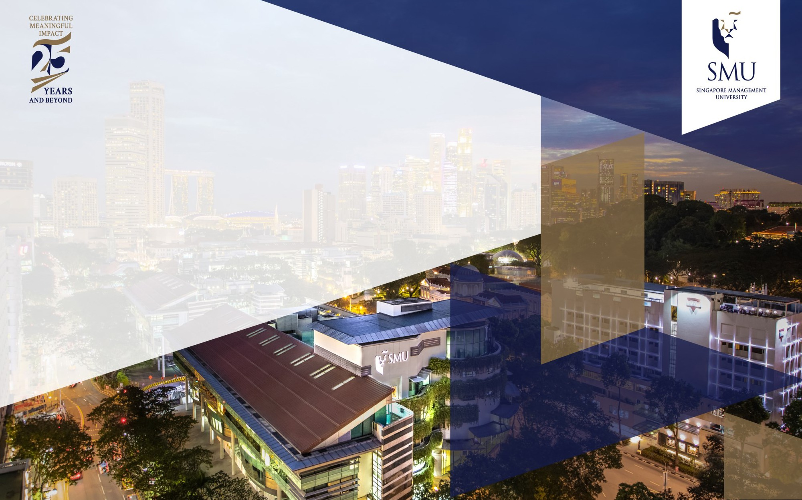
ELLSSA 2025 Issue Pitch (To increase library footfall at MDIS@Changi)
WONG Chee Keong, Benjamin
Library Executive, Management Development Institute of Singapore (MDIS)

Slide 2
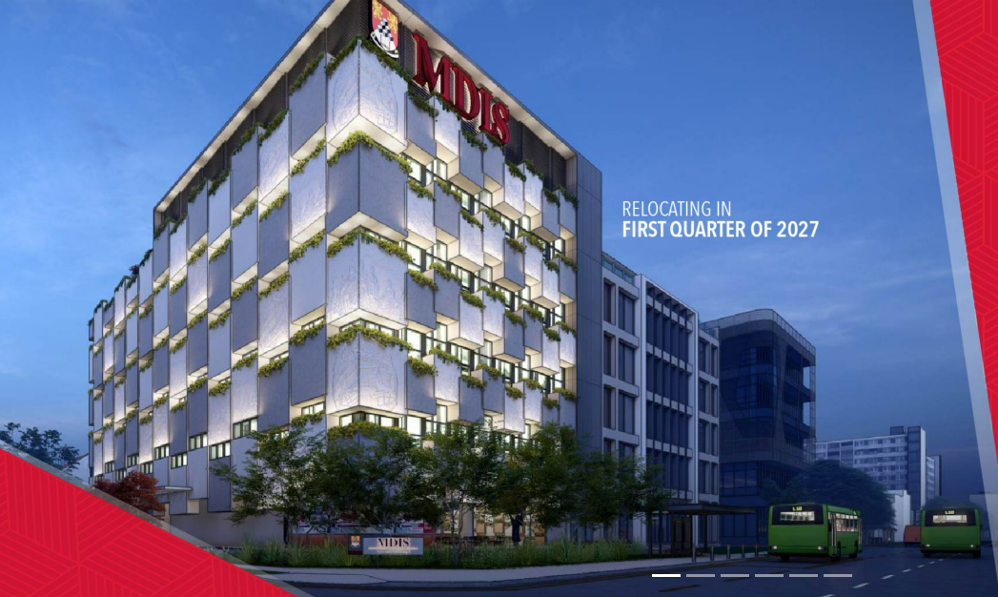
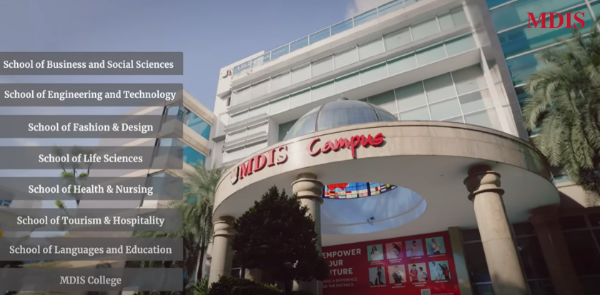
Problem Definition
MDIS Campus will be shifting from Queenstown to Eunos in the first quarter of 2027.
New campus is strategically located and well-connected via public transport (i.e. buses and MRT)
However, there is a need to provide value-added services to draw the MDIS community into Resource Hub.

Slide 3
Problem Definition
How can this be achieved?

Slide 4
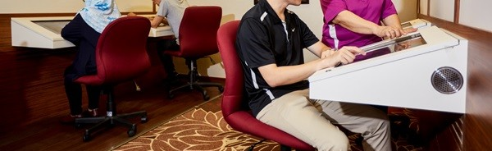
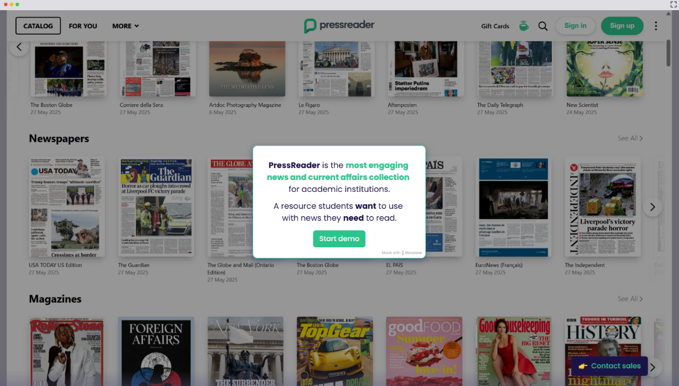
Strategic Solution
Acquisition of 2 PressReader terminals

Slide 5
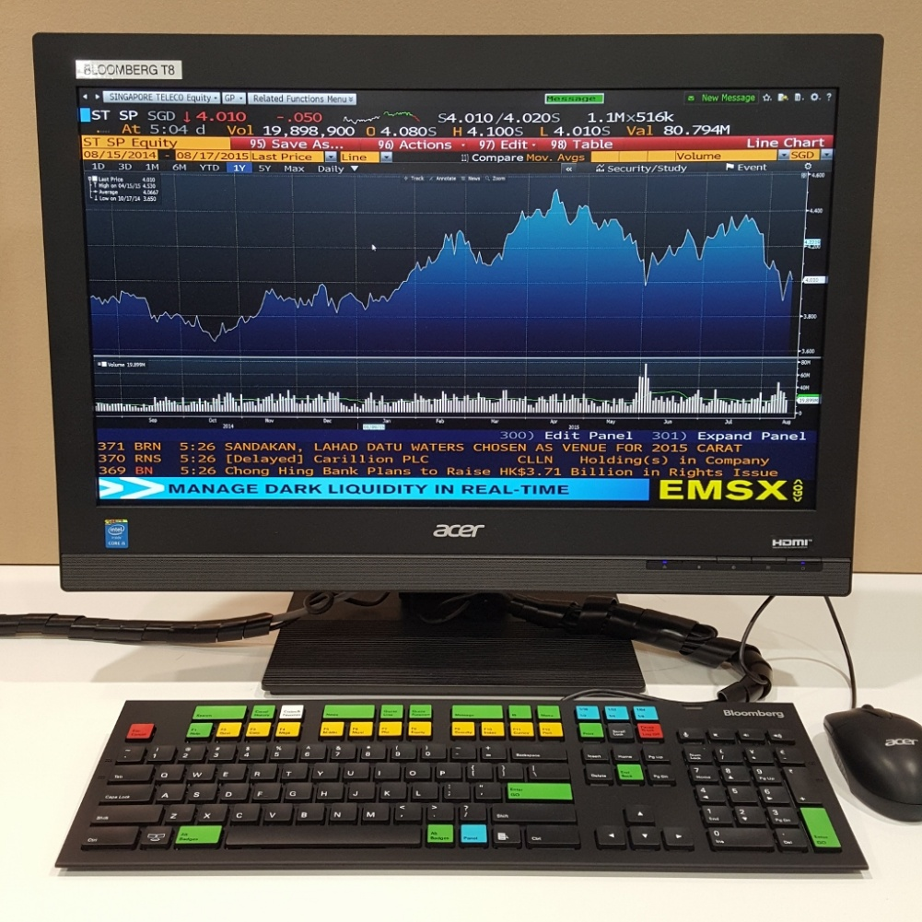
Strategic Solution
Acquisition of 1 Bloomberg terminal

Slide 6
Compelling Narrative
Currently, at MDIS@Queenstown, library users have access to physical copies of The Straits Times and The Business Times.
However, library patrons are not inclined to pick up the physical newspaper for reading.
When we implement the PressReader terminals at MDIS@Changi, MDIS staff and students will have seamless access to both local and overseas newspapers and magazines, leading to greater current affairs awareness and supporting our institution’s goal of Lifelong Learning.

Slide 7
Compelling Narrative
When we implement the Bloomberg terminal in Resource Hub at MDIS@Changi, the MDIS community, in particular students from the School of Business, will be drawn into the library, thus contributing to increased footfall and supporting the development of entrepreneurial spirit amongst students.

Slide 8
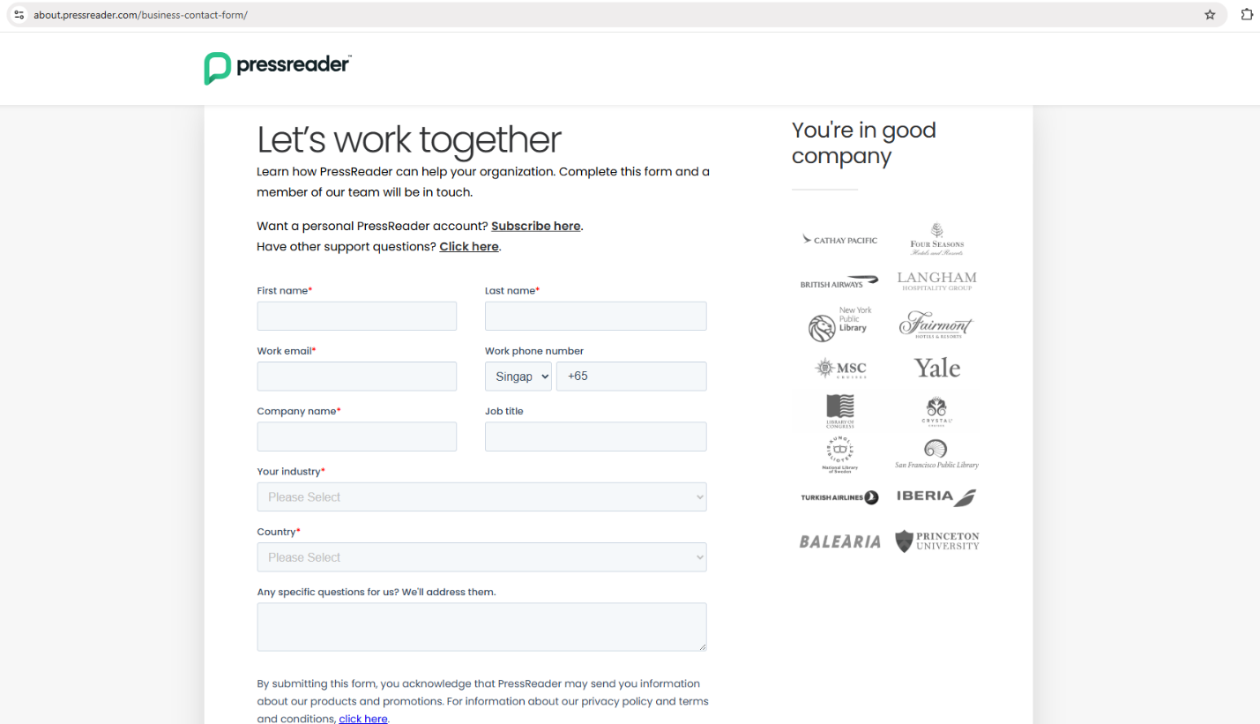
Call to Action
For the PressReader terminal acquisition, I will need to contact PressReader vendor via online contact form after obtaining my Department Head’s approval.

Slide 9
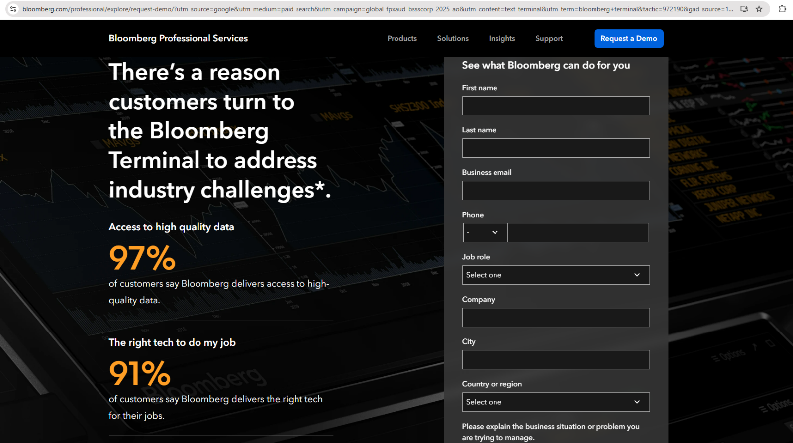
Call to Action
For the Bloomberg terminal acquisition, I will need to submit a query online via Bloomberg website, once Resource Hub has re-located to MDIS@Changi

Slide 10
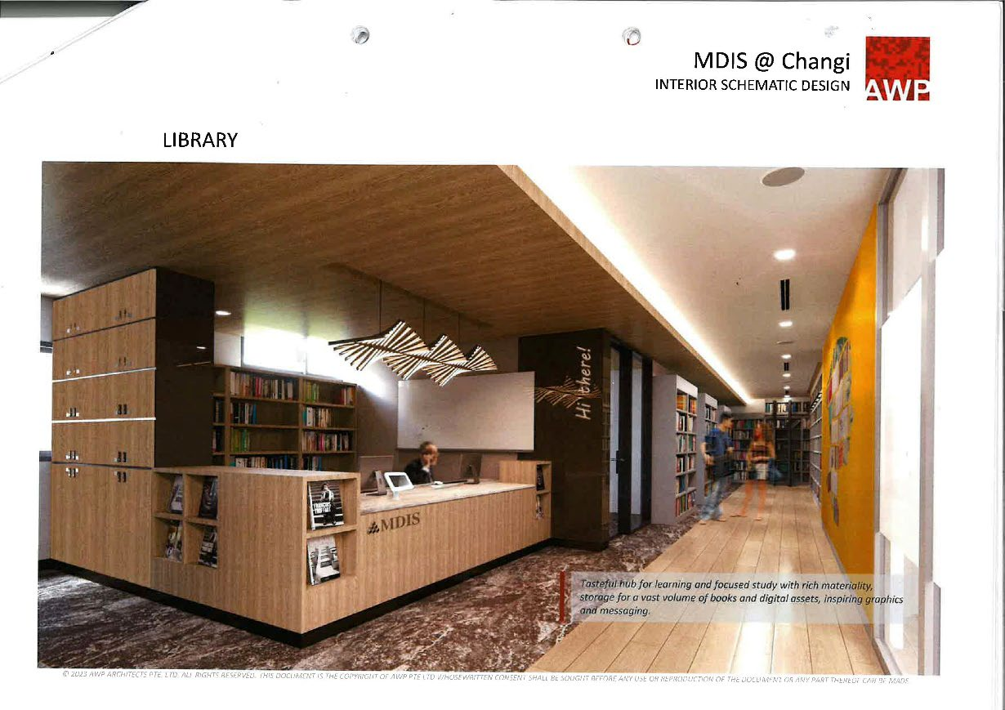
Thank you

